Slide 1
Business Modelling
Mitali Hora

Slide 2
Diagrams in UML
UML 1.4 defines nine kinds of diagrams
  Structural Diagrams (four kinds)
  Behavioral, or Dynamic, Diagrams (five kinds)
    Will not use all of them.
UML 2.0 defines 13 kinds
  Generally don’t need to worry about differences between UML 1.4 and UML 2.0.

Slide 3
UML 2.0 Diagrams and Purpose
UML diagrams | Represent the…
Use case | functionality from user’s viewpoint
Activity | the flow - within a use case or the system
Class | Classes, entities, business domain database
Sequence | the interactions between objects
Interaction Overview | interactions at a general high-level
Communication | the interactions between objects
Object | objects and their links
State Chart | the run-time lifecycle of an object
Composite Structure | Class behavior at run-time
Component | the executables, linkable libraries etc.
Deployment | the hardware nodes and processors
Package | Subsystems, organizational units
Timing | time concept during object interactions

Slide 4
Use Case
“A use case specifies the behavior of a system or a part of a system, and is a description of a set of sequences of actions, including variants, that a system performs to yield an observable result of value to an actor.”
- The UML User Guide, [Booch,99]
“An actor is an idealization of an external person, process, or thing interacting with a system, subsystem, or class. An actor characterizes the interactions that outside users may have with the system.”
- The UML Reference Manual, [Rumbaugh,99]

Slide 5
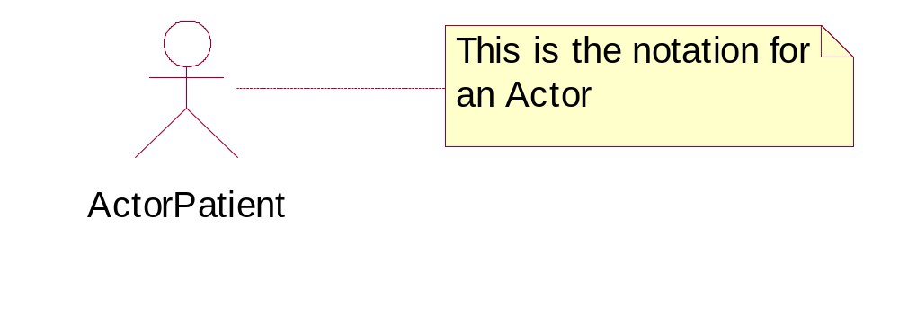
Notation for an Actor

Slide 6
Who is an Actor?
The User of the system is usually the Actor
The Actor (and not the User) is shown sending and receiving messages to and from the System
  Example: John the Branch Manager, John the Customer and John the Teller may be one and the same person
External Devices may also be Actors
  e.g. ATMs, Keypads, Printers
External Systems may also be Actors
  e.g.A Mainframe
Notes:
Not confusing the real users (for example John above) with the “roles” they play, is vital to good identification of actors.
Also, non-human actors are important in the modelling exercise with use cases.
SOME PRACTICAL TIPS:
Customer makes Inquiry by Phone to Staff
In this Scenario, Customer does not Directly interact with the System. Is this Customer an Actor?
Yes, because this Customer is direct beneficiary
System sends Messages to backend Database
This entire backend system may not have any direct user; The External system may become an actor; Otherwise, the use case diagram will be without actors.

Slide 7

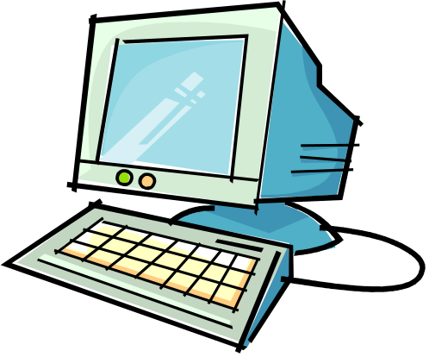
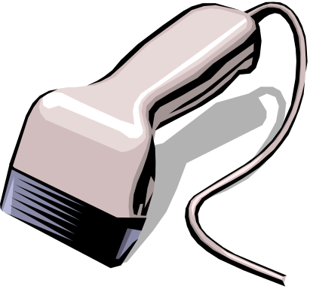
Discover Actor
An actor is a role that someone or something takes in the interaction with the system
An actor can represent a human, a machine or another system
An actor may be:
Users
External device
Other system
Notes:
Copyright © 2003 TYBRIN Corporation.

Slide 8
So, An Actor is..
Any ‘thing’ that Triggers
an Interaction
(from Outside the System)
Any ‘thing’ that Receives
a Message
(Outside the System)
Any ‘thing’ that is Outside the System
Notes:
Actors
represent the user(s) of the system
interact with the system through use cases
may participate in more than one use case
may or may not be represented as a class or object in the object model

Slide 9
Finding Actors
  Who provides/uses Information to/from the System?
  Who Supports this Functionality?
  Which other Systems will this System Interact with?
  The External Devices (Keypads, Printers etc.) that the system will Interact with
  Process Comment: Produce first cut of the list of Actors, then Cull them after drawing Initial Use Case diagrams

Slide 10
Actor: Variations
Primary Actor:
  The first or main Actor who uses the system (e.g. Teller)
  The main Actor who benefits from the system (e.g. Customer)
Secondary Actor:
  The Actor who derives indirect benefits from or uses the system ; Depends on Perspective
Abstract and Concrete Actors:
  Due to Generalization to reduce Complexity

Slide 11
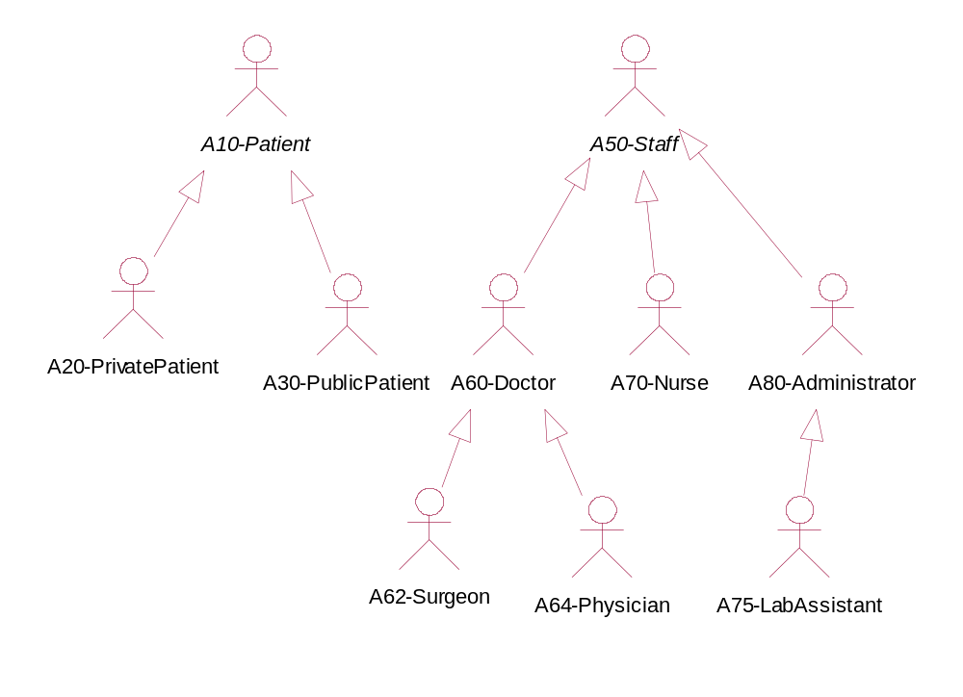
Abstract versus Concrete Actors and a corresponding Actor hierarchy in Hospital Management System

Slide 12
What is a Use Case?
A use case describes a sequence of actions, performed by a system, that provides value to a particular actor
  Action
    An action is atomic
  Sequence of Actions
    Specific flow of events through the system.
    Group similar flows of events into a single use case
  Performed by a system
    Concerned with what the system does in order to perform the sequence of actions.
    The Use Case helps us to define a firm boundary around the system and what it does to separate it from the outside world
  Provide Value
    Ensures the use case has relevance
    At a level of granularity that can be understood by the user
  Particular Actor
    Focusing on a particular actor forces us to isolate the value provided to specific groups of users of the system, ensuring that the system does what they need it to do
Notes:
Copyright © 2003 TYBRIN Corporation.

Slide 13
Use cases help ..
· Capture the system's functional requirements from the users' perspective
· Actively involve users in the requirements-gathering process
· Provide the basis for identifying major classes and their relationships
· Serve as the foundation for developing system test cases

Slide 14
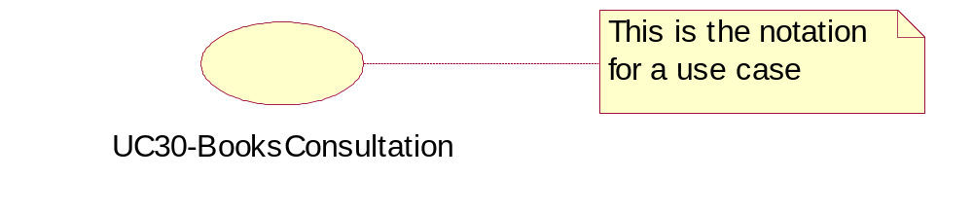
Notation for a Use case

Slide 15
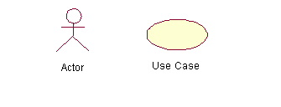
Use Case Diagram (core components)
Actors: A role that a user plays with respect to the system,including human users and other systems. e.g.,inanimate physical objects (e.g. robot); an external system that needs some information from the current system.
Use case: A set of scenarios that describing an interaction between a user and a system, including alternatives.
System boundary: rectangle diagram representing the boundary between the actors and the system.it will show scope of the system.

Slide 16
Use Case Diagram(core relationship)
Association: communication between an actor and a use case; Represented by a solid line.
Generalization: relationship between one general use case and a special use case (used for defining special alternatives)
Represented by a line with a triangular arrow head toward the parent use case.

Slide 17
Use Case Diagram(core relationship)
Include: a dotted line labeled <<include>> beginning at base use case and ending with an arrows pointing to the include use case. The include relationship occurs when a chunk of behavior is similar across more than one use case. Use “include” in stead of copying the description of that behavior. Compulsory actions that can be show by include.Exp. For login registration is compulsory.So we can say login includes registration.
<<include>>
Extend: a dotted line labeled <<extend>> with an arrow toward the base case. The extending use case may add behavior to the base use case. The base class declares “extension points”.It will show extra feature.Exp.Forgot psw change pwd are extra features.every oe will not use it.So it can be extend.
<<extend>>

Slide 18
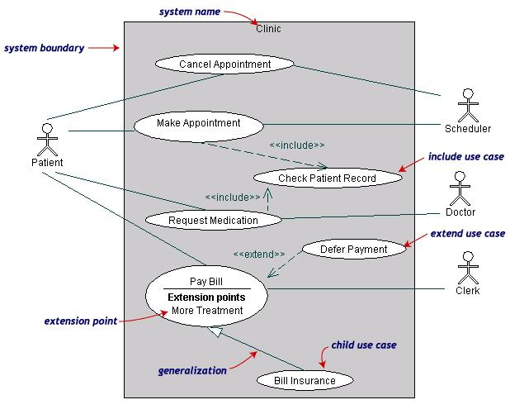
Use Case Diagrams(cont.) - Example

Slide 19
Use Case Diagrams(cont.)
Pay Bill is a parent use case and Bill Insurance is the child use case. (generalization)
Both Make Appointment and Request Medication include Check Patient Record as a subtask.(include)
The extension point is written inside the base case
Pay bill; the extending class Defer payment adds the behavior of this extension point. (extend)

Slide 20
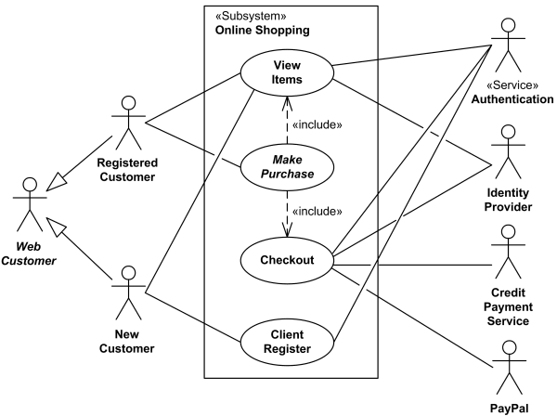
Use Case Diagrams(cont.) - Example

Slide 21
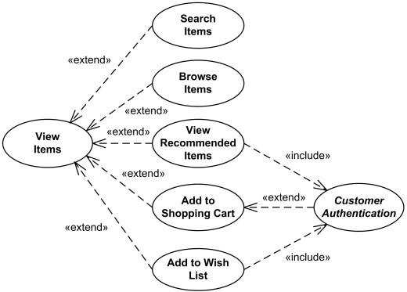
Use Case Diagrams(cont.) - Example

Slide 22
Use Case Diagrams(cont.)
View Items use case is extended by several optional use cases - customer may search for items, browse catalog, view items recommended for him/her, add items to shopping cart or wish list. All these use cases are extending use cases because they provide some optional functions allowing customer to find item.
Customer Authentication use case is included in View Recommended Items and Add to Wish List because both require customer to be authenticated. At the same time, item could be added to the shopping cart without user authentication.

Slide 23
SWOT of Use Case Diagrams
Strengths
1.Models the Important user as Actor
2.Organizes Requirements
3. Facilitates communication
4.Documents all Functionality
5. Reuses and extends requirements
4.Facilitates Traceability of Reqs.
5.Provides System Context/Boundary
Weaknesses
1.Not object-oriented
2. Have no documentation standards
3.Imprecise Relationships
(arrowhead, stereotype)
4. Has no Flow
Objectives
1.Visualize how system is used
2.Scope and Prioritize requirements
3.Facilitate project estimation
4. Facilitate contract management
5. Starting point for other diagrams
Traps
1.Can’t express Non-functional req.
2.Ignoring internal use case doc.
3. Coding directly from use cases
4. Use case driven project plans

Slide 24
Use Edraw max tool for the diagrams
This is the reference link for reference purpose
https://www.edrawsoft.com/create-use-case-diagram.php

